Slide 1
marge sort algorithm

Slide 2
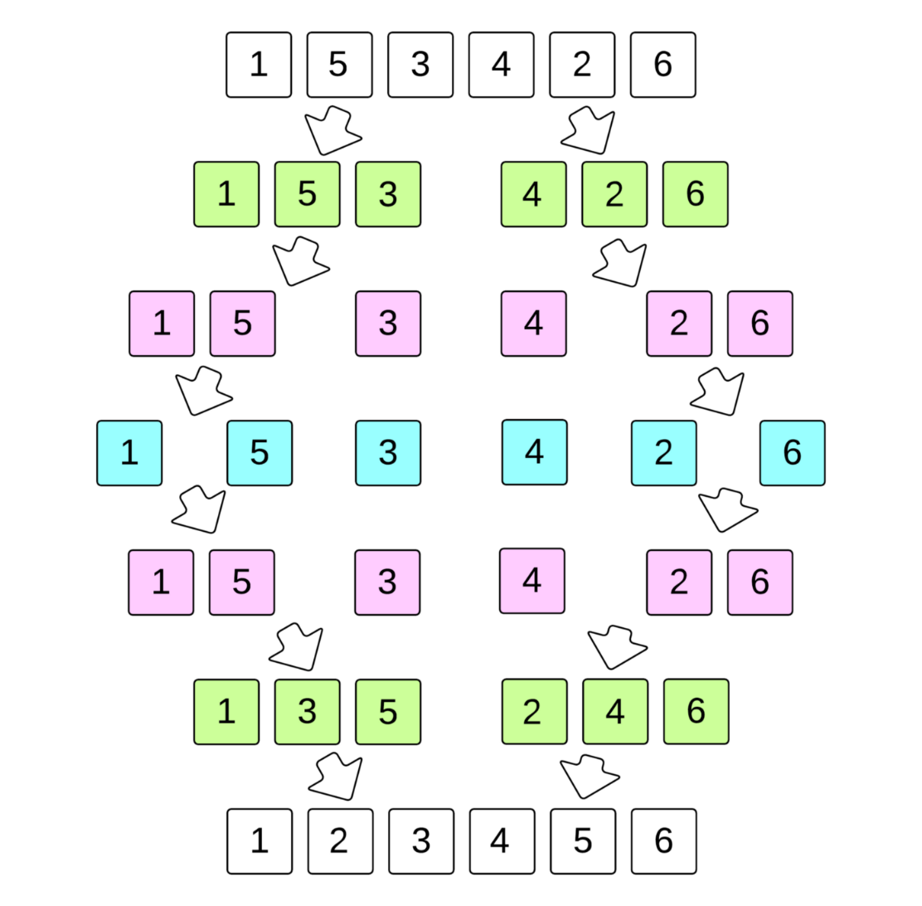
Introduction
Merge sort is a divide-and-conquer algorithm based on the idea of breaking down a list into several sub-lists until each subsist consists of a single element and merging those subsists in a manner that results into a sorted list
Merge Sort Algorithms Steps:
If it is only one element in the list it is already sorted, return.
Divide the list recursively into two halves until it can no
more be divided.
Merge the smaller lists into new list in sorted order.

Slide 3
Introduction
Advantages of using merge sort algorithm:
It is quicker for larger lists because unlike insertion and bubble sort it doesn’t go through the whole list several times.
It has a consistent running time, carries out different bits with similar times in a stage.
Disadvantages of using merge sort algorithm:
extra space to store subarrays
slow for small arrays
the algorithm does the whole process even the array is already sorted.

Slide 4
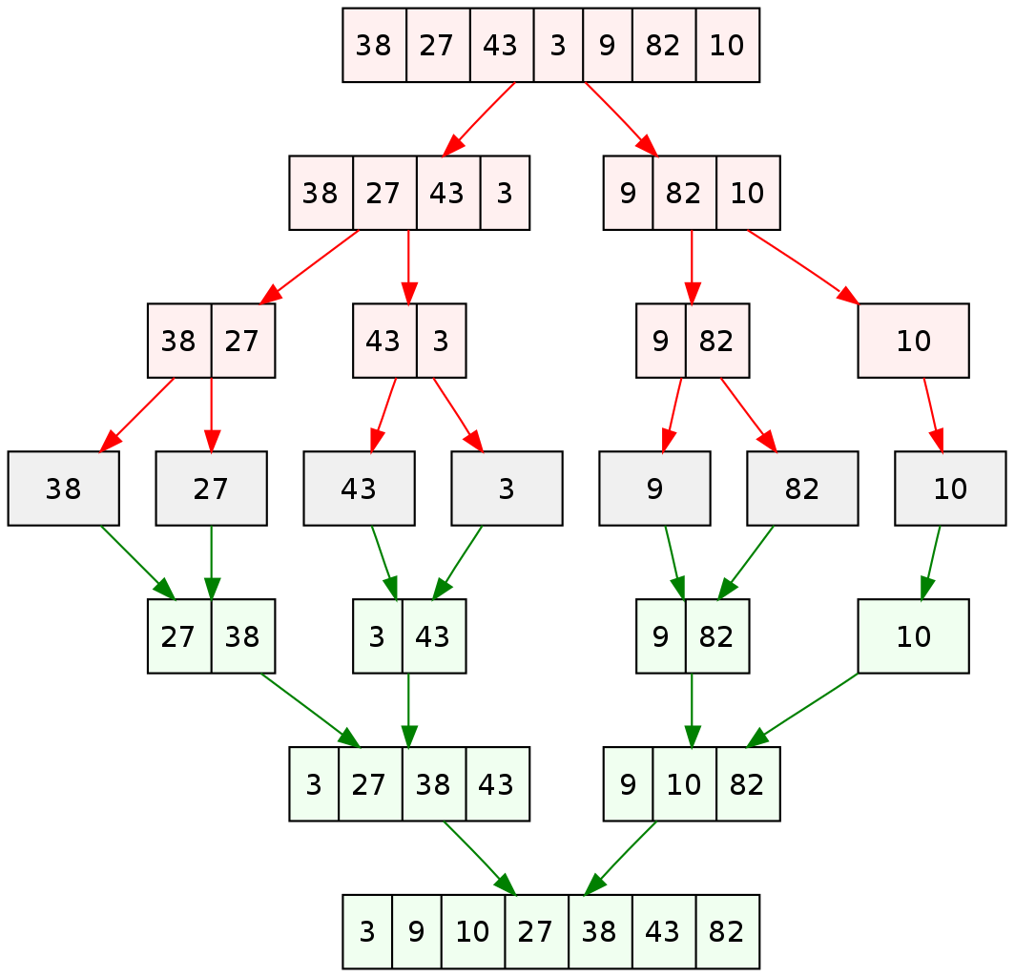
Analysis
Merge Sort is a Divide and Conquer algorithm. It divides the input array into two halves, calls itself for the two halves, and then merges the two sorted halves. The merge() function is used for merging two halves. The merge(arr, l, m, r) is a key process that assumes that arr[l..m] and arr[m+1..r] are sorted and merges the two sorted subarrays into one. MergeSort(arr[], l,m ,r).
The following diagram from shows the complete merge sort process for an example array {38, 27, 43, 3, 9, 82, 10}. If we take a closer look at the diagram, we can see that the array is recursively divided into two halves till the size becomes 1. Once the size becomes 1, the merge processes come into action and start merging arrays back till the complete array is merged.

Slide 5
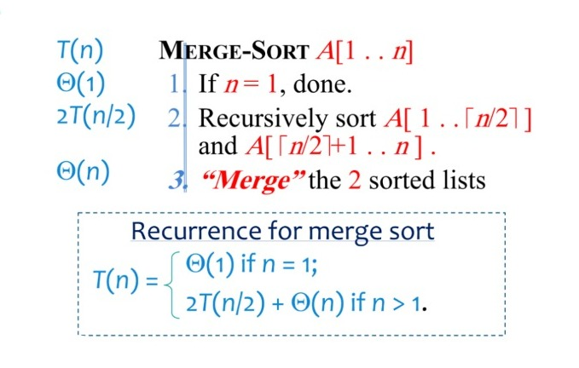
Running Time

Slide 6
Analysis
Kind of analysis:
Worst-case:
T(n) = maximum time of algorithm on any input of size n
Average-case:
T(n) = expected time of algorithm over all inputs of size n.
Best-case:
T(n) = minimum time of algorithm (fastest time to complete, withoptimal inputs chosen)

Slide 7
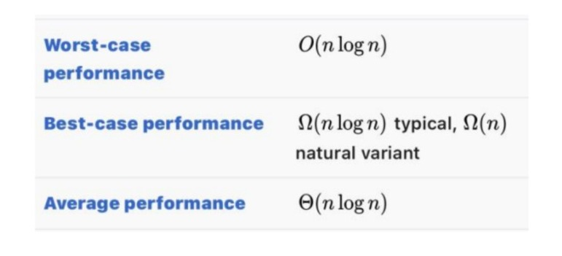
Running Time

Slide 8
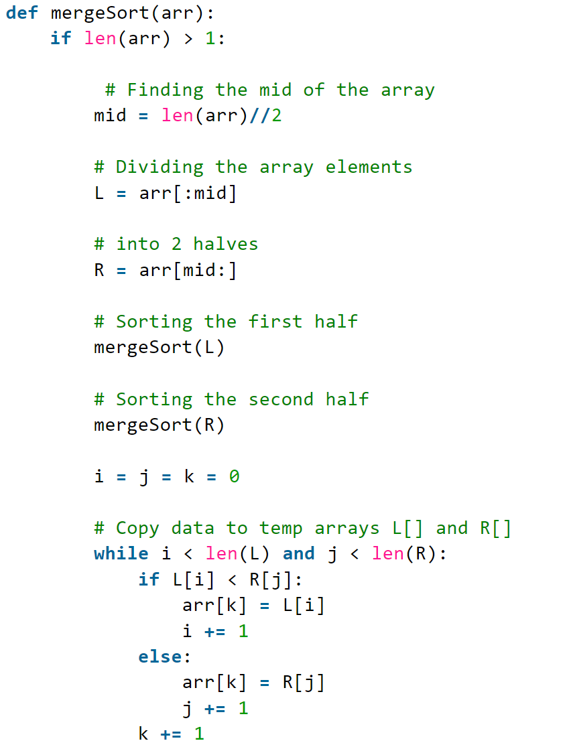
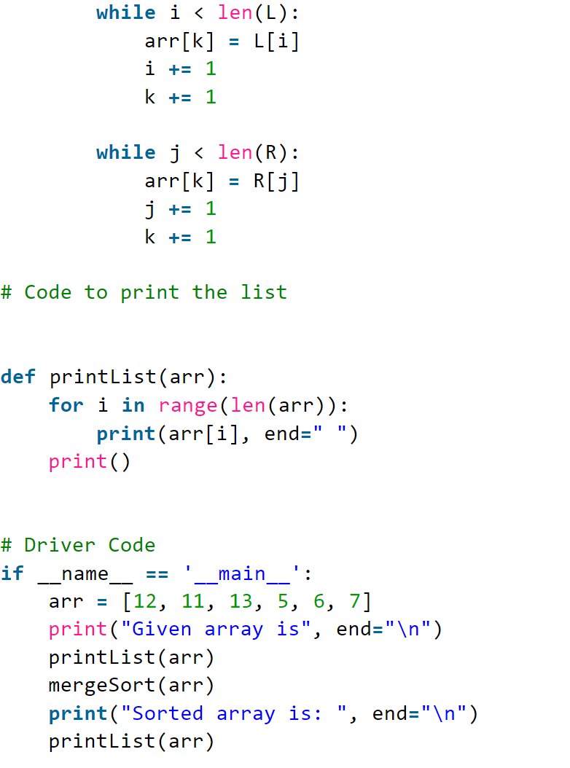
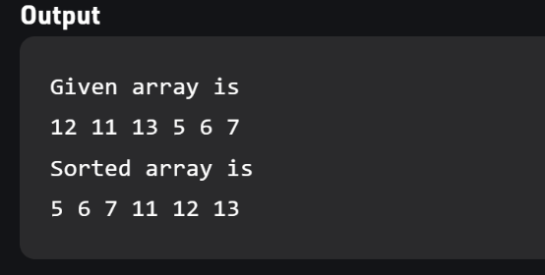
Python code

Slide 9
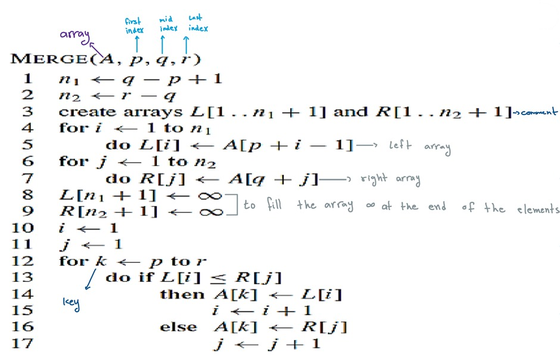
Pseudocode for merge sort algorithm

Slide 10
Our point of view Merge sort is one of the most efficient sorting algorithms in computer science , it’s works on larger numbers rather than smaller numbers, if we want to sort array has n >30 elements its well be efficient for this elements

Slide 11
Thank you for listening

